Slide 1
Welcome to the ENEON Launch
Prof. Thierry Ranchin,
Director of Centre Observation, Impacts, Energy

Slide 2

MINES ParisTech : Partnership research in link with industry and economy
Under responsability of the Ministry of Industry
2,395 people :
1,114 permanent staff including 286 research academics
391 student researchers
890 other students
18 research centers in 5 departments (Earth sciences and environment, Mechanical and Materials engineering, Energy and Processes, Mathematics and Systems and Economics, management, society)
5 sites : Paris, Evry, Fontainebleau, Palaiseau, Sophia Antipolis

Slide 3



Excellence in Training: 6 Programs
Corps des Mines engineers (27 students): top-ranking graduates from the École Polytechnique, MINES ParisTech and the École Normale Supérieure
Master’s degree in science and engineering / Ingénieurs civils des Mines (155 students): admitted to the first year from the «classes préparatoires» and to the second year from the École Polytechnique and French and foreign universities
Masters programmes (19 students): Bachelor’s degree
Advanced masters /Mastères spécialisés (155 students): graduate engineers or equivalent
Doctorate students (114): Master’s degree or equivalent
Institut supérieur des techniques (17 students): high-grade technicians with five years of professional experience
The figures indicate the number of students graduated in 2012

Slide 4
Excellence with industry, ARMINES: Contractual research structure linked with MINES ParisTech
Non profit Private Structure (association loi 1901)
Created in 1967
Partnership with les Ecoles des mines sous tutelle du MINEFE (Paris, Saint-Etienne, Douai, Alès, Nantes, Albi-Carmaux), X, ENSTA, Navale, ENPC
Public/Private administrative board
561 employees, volume of activities (2014): 45 M€, more than 50 labs
Partnership Research
Strong link with European Research Programmes
Valorization of the results of research: Transvalor SA, 6 M€ (Volume of activities in 2014), 60 employees)
Domains: Social and engineer sciences
Regional, National, European networks (AICarnot, ASRC, EARTO)
Notes:
AICarnot = Association des Instituts Carnot
ASRC = Association des Structures de Recherche Contractuelle
EARTO = European Association of Research and Technological Organisations.

Slide 5
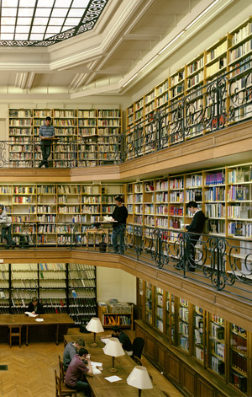
Academic Excellence
90 theses, 400 articles or books published annually
Laboratories run jointly with the French National Center for Scientific Research (CNRS), École Polytechnique, École des Ponts ParisTech, ENSTA ParisTech, the French National Institute for Research in Computer Science and Control (INRIA)…
Partnerships with foreign universities
Scientific evaluation and guidance committees

Slide 6
From Observation of resources to environmental Impacts of renewable Energy sectors
Centre Observation, Impacts, Energy
Department Energy and Processes

Slide 7
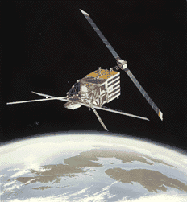
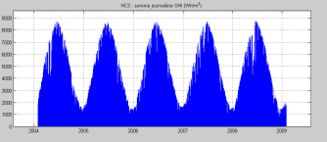
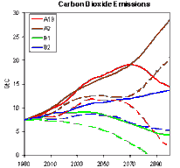
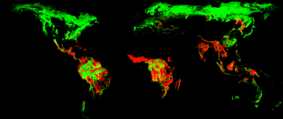
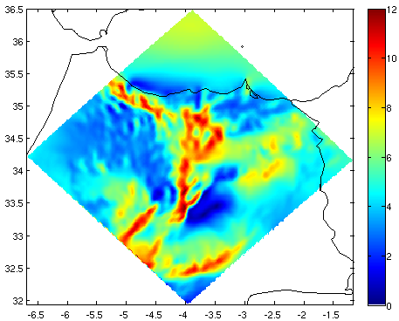
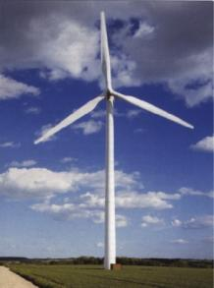


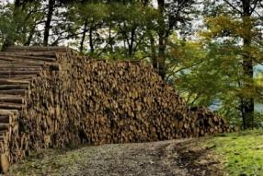
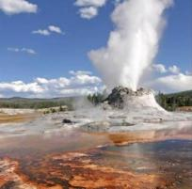
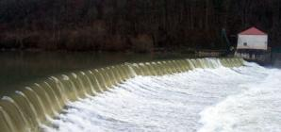
Centre Observation, Impacts, Energy
Observation
Environmental Impacts
Renewable Energy

Slide 8
Centre Observation, Impacts, Energy
Main scientific concern: caracterisation and analysis of spatial and temporal aspects
of renewable energy resources
of environmental impacts of energy sectors
Main research activities:
Exploitation of Earth Observation Data
Evaluation of renewable energy resources using Earth Observation data
Methodological developments, evaluation and information for decision making in order to reduce environmental impacts through the use of Life Cycle Assessment (LCA) approaches
Dissemination of scientific data through Web services
Scientific Domains: Applied Mathematics, Physics, Metrology, Environmental sciences, Information and Communication Technologies (ICT)

